Slide 1
Mission 4 Remix
Create your own project from Mission 4

Slide 2

Pre-Mission Preparation
In the Mission 4 Remix Log, answer the pre-mission preparation questions:
What was something cool about Mission 4?
What was something challenging about Mission 4?

Slide 3

Time for a project remix!
A remix can be:
A new program created by adding new code to a program you already created
You can combine parts of two or more programs in a remix
Use a similar idea in a different way

Slide 4
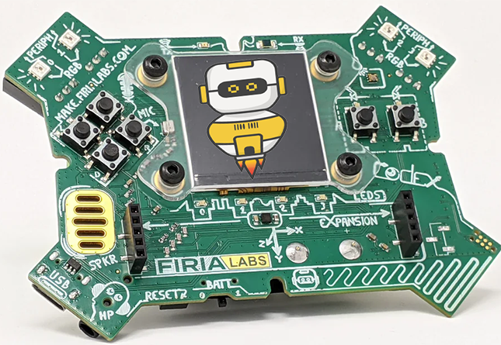
Project Remix
Creating a remix will let you:
Master the skills and concepts practiced in the mission
Be creative
Remember code from earlier programs and missions
Work with your peers
Design an original program and write the code all on your own

Slide 5
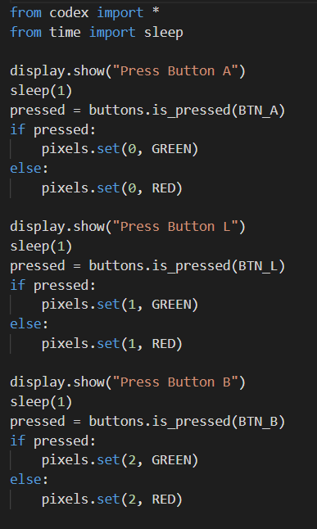
Step #1
Review the mission
Open your project from
Mission 4
  What does the program do?
  What skills were used or concepts learned?
DO THIS:
Fill out the information in the Mission 4 Remix Log for Step 1

Slide 6
Step #2
Brainstorm ideas
Read through remix suggestions from your teacher
Three suggestions are on the next 2 slides. You can use one of these ideas or come up with your own.

Slide 7
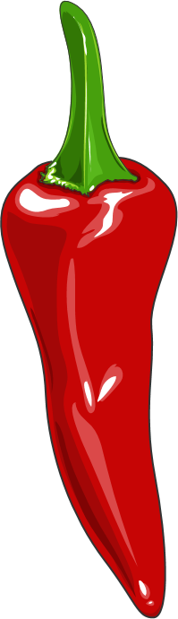
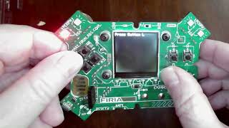
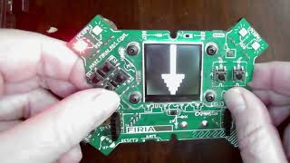
Step #2 Remix Ideas
Mild
Add images to the code. When a pixel turns green, display an image like a happy face. When a pixel turns red, display a different image, like a sad face.
Medium
Use images instead of printed instructions. There are arrow images available. Display an arrow and check for the correct button. For example, the north arrow goes with BTN_U.
Ctrl-Click the images to see the videos

Slide 8
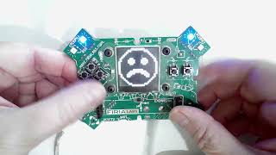
Step #2
Ctrl-Click the image to see the video
Spicy
Use a color of pixel to indicate which button to press. For example, if a pixel turns red, press BTN_U. If a pixel turns blue, press BTN_D. And so forth. You could use six colors and all six buttons. Display one image (like the happy face) if they choose correctly and a different image (like a sad face) if they are wrong. You may want to include a set of print statements at the beginning that tell the button and color combination.

Slide 9
Step #2
Brainstorm ideas
Read through remix suggestions from your teacher (previous slides)
Use your creativity to come up with your own idea for a project
Decide with your partner what project you will do
DO THIS:
Fill out the information in the Mission 4 Remix Log for Step #2

Slide 10
Step #3
Make a plan
What variables will you need?
  Note: you do not have to use a variable for this remix
What images will you display?
DO THIS:
Fill out the information in the Mission 4 Remix Log for Step #3

Slide 11

Step #4
Code your project
IMPORTANT: Go to the sandbox to code the remix project
  Above toolbox in the lower left corner
Start with a new file and give it a descriptive name (Remix4)
You can leave Display open (use it as a guide)
Import your modules
Define your variables
Write your code, testing frequently

Slide 12
Step #4
Stop and test frequently!
Don’t try to write all the code at one time
Mistakes happen, so find them early
Type just a few lines of code and then run the program
If there is an error, fix it before continuing
Use the debugger and your other programs for help

Slide 13
Step #5
Documentation!
Make sure your code is readable by adding blank lines
Add comments to sections of your code that explain what they do

Slide 14
Step #5
Get feedback
Show your code to other students
What do they think? Have them fill out the feedback form on your Mission 4 Remix Log
Give yourself some feedback Is there something you want to change or improve or add? Fill out the feedback form on your Mission 4 Remix Log
Modify your code to make your project even better

Slide 15

And now you have your own remix!
Congratulations!
By completing this remix you have:
learned more about programming
begun mastering the skills and concepts from the missions
been thinking! And problem solving and much more!

Slide 16
Mission Reflection
Wow! Great job!
Share your project with your friends!
Complete your Mission 4 Remix Log
Don’t forget to clear your CodeX by running your Clear program

